Slide 1



Joanna Spychała
Migrant Info Point
Information and support for foreigners
Poznań 2022

Slide 2



Slide 3


Slide 4
Migrant Info Point office – free information and advisory support for immigrants
Information concerning the legalization of stay (e.g temporary and permanent stay permits), citizenship, obtaining a PESEL number
Information concerning the job market (e.g. work permits, starting a business)
Information concerning daily life in Poznań

Slide 5
Migrant Info Point office – free information and advisory support for immigrants
Explanation of the processes and procedures
Help with completing official forms
Ongoing support during the entire legalization process
Legal support
Polish language courses
All our services are free of charge

Slide 6
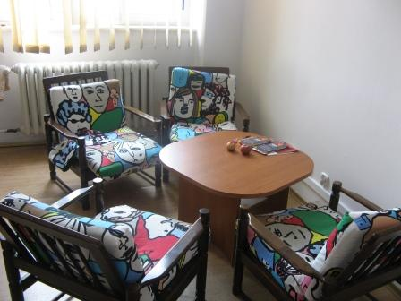
How to arrange a meeting?
Contact us:
Via email office@migrant.poznan.pl, or on the phone: 503 979 758
Waiting time: usually no longer than 2-3 days
It's necessary to make an appointment before coming to the office

Slide 7
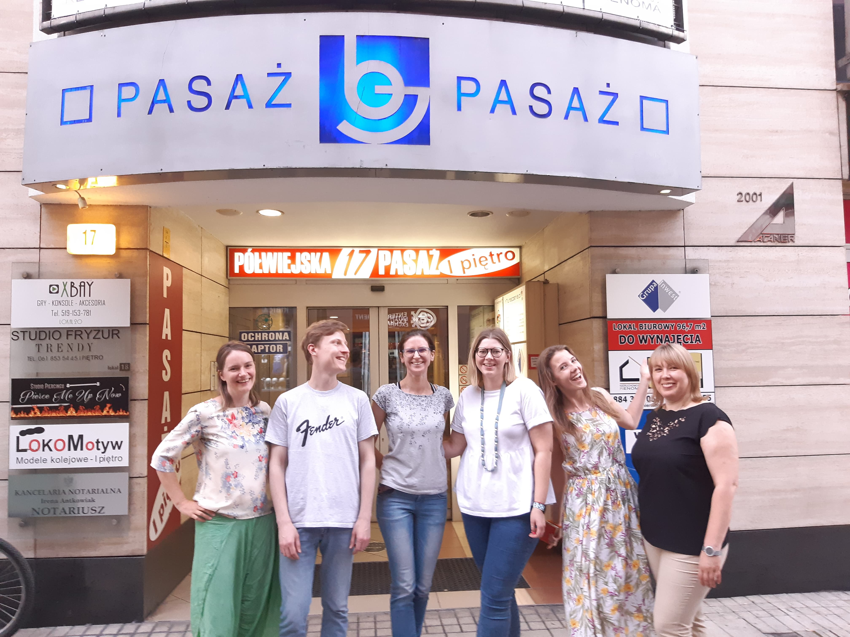
Where to find us?
MIP is a part of POINT – Poznan Integration Centre
Our address: Półwiejska 17/27, 2nd floor
Opening hours:
  Mon – Thu: 9 a.m. – 8 p.m.
  Fri: 9 a.m. – 6 p.m.

Slide 8

Where to find us?
Facebook
MIP: www.facebook.com/migrantinfopoint
POINT: https://www.facebook.com/PointPoznan/
.

Slide 9
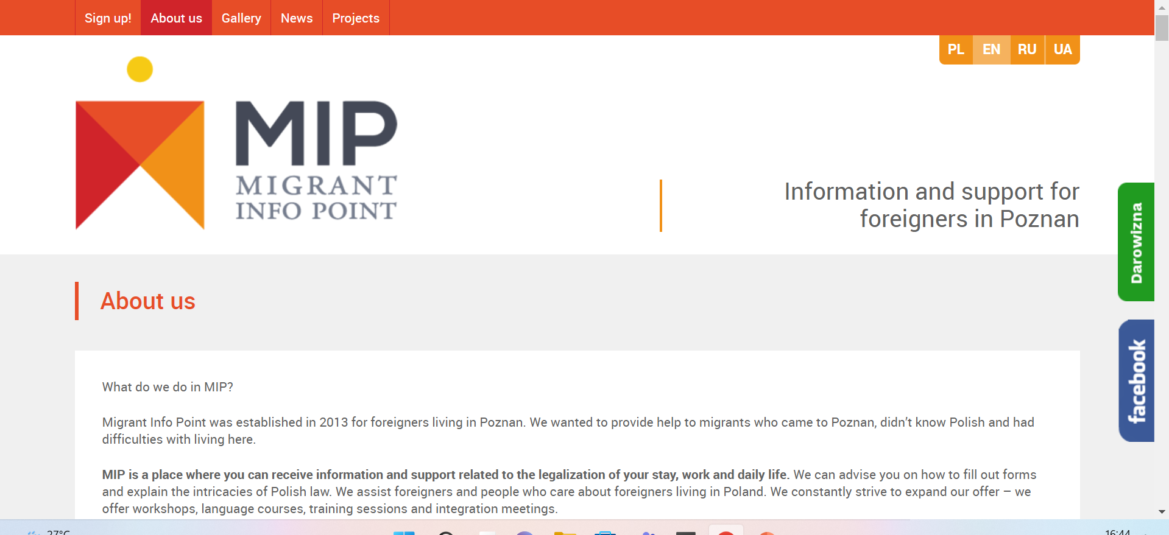
Where to find us?
Website
http://migrant.poznan.pl/en/

Slide 10

What else do we do?

Slide 11
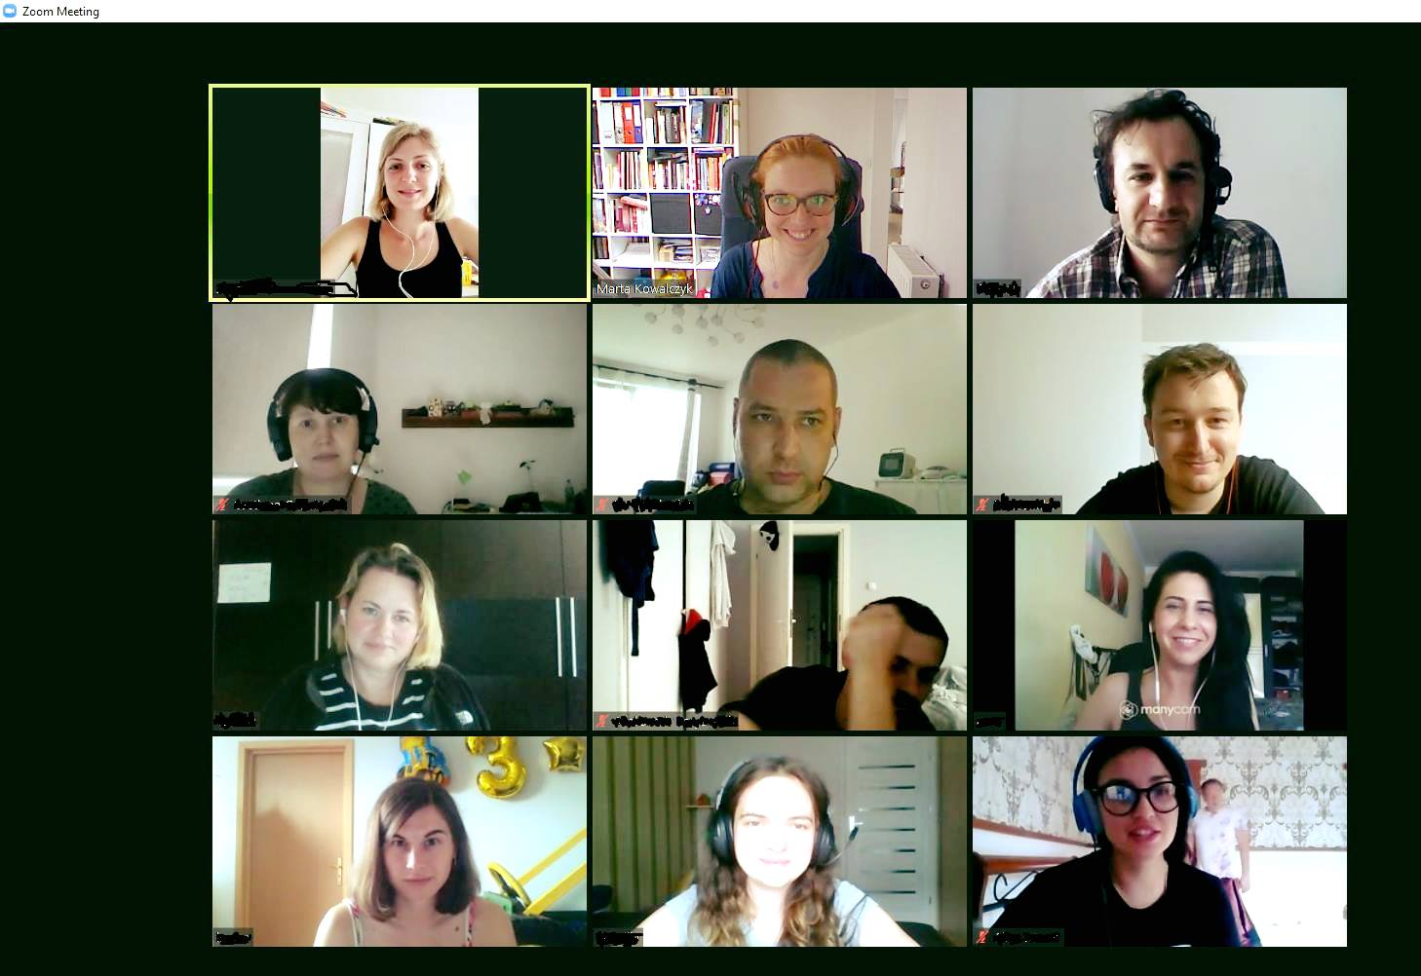
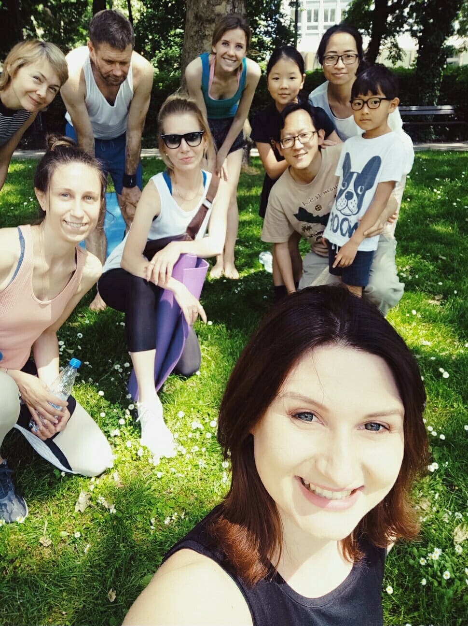
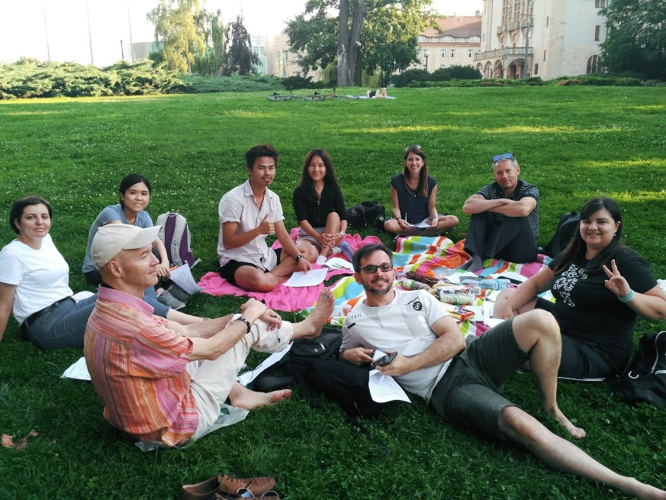
Activites for adults

Slide 12

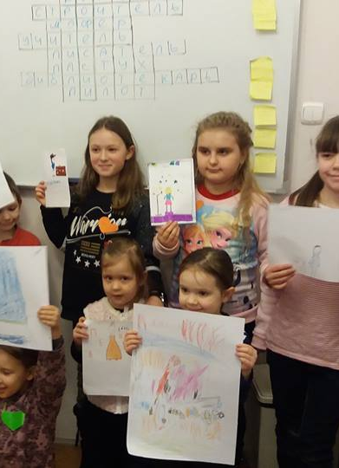
For kids

Slide 13

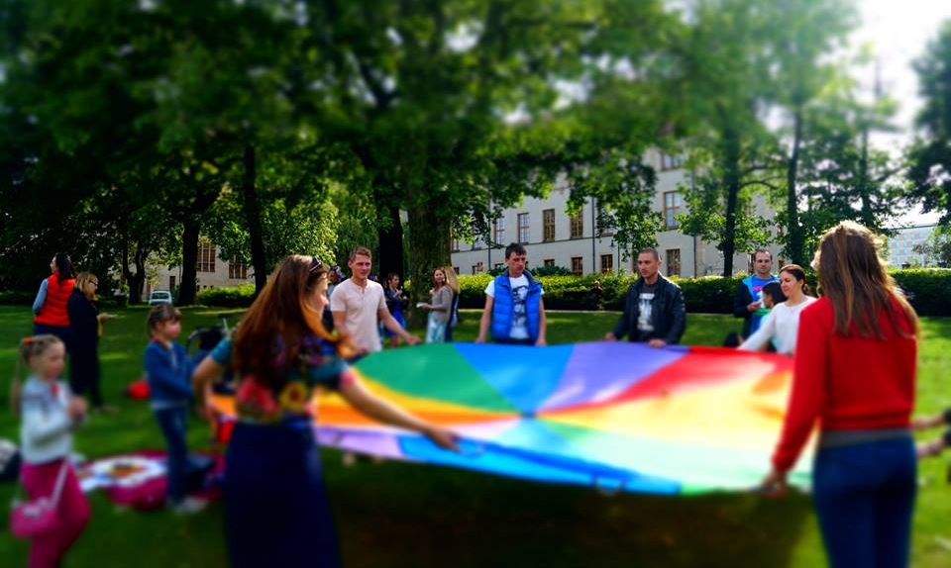
For all

Slide 14
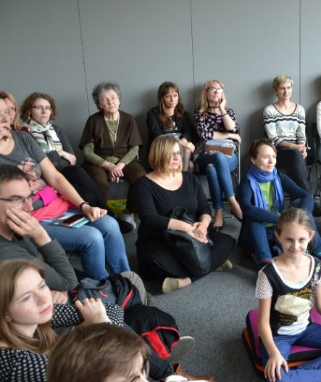

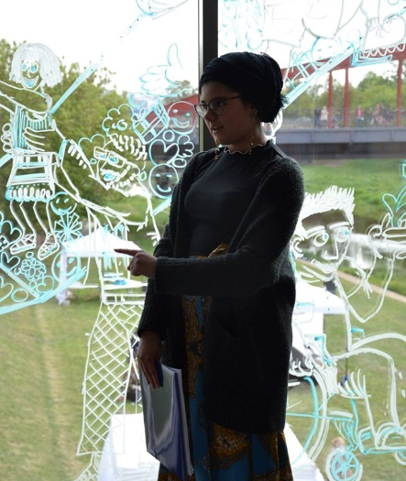

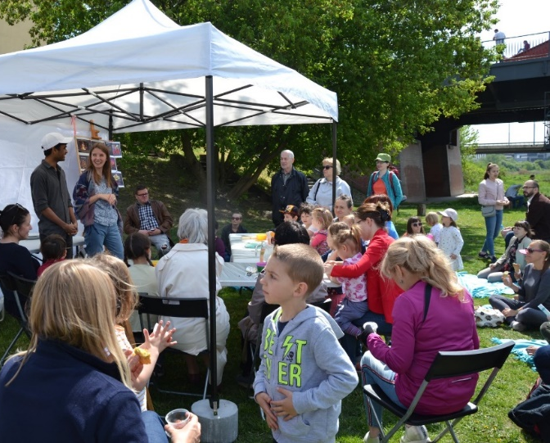
You can also volunteer with us! ☺

Slide 15
Useful links
The Foreigners’ Office in Poznań: https://migrant.poznan.uw.gov.pl/en
The Foreigners’ Office in Warsaw: https://udsc.gov.pl/en/
Polish National Agency of Academic Exchange: https://nawa.gov.pl/
The City Council website: https://www.poznan.pl/mim/main/en/
The Border Guards: https://www.nadodrzanski.strazgraniczna.pl/nad/cudzoziemcy

Slide 16

Thank you for your attention!
www.migrant.poznan.pl
Facebook: Migrant Info Point
office@migrant.poznan.pl
503 979 758

